Slide 1



Test with JUnit
Version 2 - April 2013
© Maurizio Morisio, Marco Torchiano, 2013

Slide 2

Licensing Note
Attribution-NonCommercial-NoDerivs 2.5
You are free: to copy, distribute, display, and perform the work
Under the following conditions:
Attribution. You must attribute the work in the manner specified by the author or licensor.
Noncommercial. You may not use this work for commercial purposes.
No Derivative Works. You may not alter, transform, or build upon this work.
For any reuse or distribution, you must make clear to others the license terms of this work.
Any of these conditions can be waived if you get permission from the copyright holder.
Your fair use and other rights are in no way affected by the above.
This is a human-readable summary of the Legal Code (the full license) found at the end of this document

Slide 3
Motivation
Why testing?
  Improve software design
  Make software easier to understand
  Reduce debugging time
  Catch integration errors
In short, to produce better code
Preconditions
  Working code
  Good set of unit tests

Slide 4
What is test case
A test case is a document that describes
  an input, action, or event
  and an expected response,
  to determine if a feature of an application is working correctly

Slide 5
Good test case design
A good test case satisfies the following criteria:
  Reasonable probability of catching an error
  Does interesting things
  Doesn’t do unnecessary things
  Neither too simple nor too complex
  Not redundant with other tests
  Makes failures obvious
  Mutually Exclusive, Collectively Exhaustive

Slide 6
Testing with JUnit
JUnit is a testing framework for Java programs
  Idea of Kent Beck
It is a framework with unit-testing functionalities
Integrated in Eclipse development Environment
http://www.junit.org

Slide 7
JUnit
JUnit is a framework for writing unit tests
  A unit test is a test of a single class
    A test case is a single test of a single method
    A test suite is a collection of test cases

Slide 8
JUnit
Unit testing is particularly important when software requirements change frequently
  Code often has to be refactored to incorporate the changes
  Unit testing helps ensure that the refactored code continues to work

Slide 9
JUnit..
JUnit helps the programmer:
  Define and execute tests and test suites
  Formalize requirements and clarify architecture
  Write and debug code
  Integrate code and always be ready to release a working version

Slide 10
What JUnit does (1)
JUnit runs a suite of tests and reports results
For each test method in the test suite:
  JUnit calls the method
  If the methods terminates without problems
    The test is considered passed.

Slide 11
What JUnit does (1)
JUnit runs a suite of tests and reports results
For each test (method) in the test suite:
  JUnit calls setUp()
    This method should create any objects you may need for testing

Slide 12
What JUnit does… (2)
JUnit calls one test method
  The test method may comprise multiple test cases; that is, it may make multiple calls to the method under test
  In fact, since it’s your code, the test method can do anything you want
  The setUp() method ensures you entered the test method with a virgin set of objects; what you do with them is up to you

Slide 13
What JUnit does… (3)
  JUnit calls tearDown()
    This method should remove any objects you created

Slide 14
The structure of a test method
A test method doesn’t return a result
If the tests run correctly, a test method does nothing
If a test fails, it throws an AssertionFailedError
The JUnit framework catches the error and deals with it; you don’t have to do anything

Slide 15
Assert*()
For a condition
  assertTrue(“message when test fails”, condition);
If the tested condition is
  True => execute the following instruction
  False => break to the end of the test method, print out the optional message

Slide 16
Assert (2)
For objects, int, long, byte:
  assertEquals( expected value, expression);
  Es. assertEquals( 2 , unoStack.size() );
For floating point values:
  assertEquals( expected value, expression, error);
  Es. assertEquals(1.0, Math.cos(3.14), 0.01);

Slide 17
Test Example
Extends TestCase
public class StackTest extends TestCase {
public void testStack() {
Stack aStack = new Stack();
assertTrue(“Stack should be empty!”,
aStack.isEmpty());
aStack.push(10);
assertTrue(“Stack should not be empty!”,
aStack.isEmpty());
aStack.push(-4);
assertEquals(-4, aStack.pop());
assertEquals(10, aStack.pop());
}
}
Test method name: testSomething
One or more assertions to check results

Slide 18
Testing a stack...
public void testStackEmpty() {
Stack aStack = new Stack();
assertTrue(“Stack should be empty!”,
aStack.isEmpty());
aStack.push(10);
assertTrue(“Stack should not be empty!”,
!aStack.isEmpty());
}
public void testStackOperations() {
Stack aStack = new Stack();
aStack.push(10);
aStack.push(-4);
assertEquals(-4, aStack.pop());
assertEquals(10, aStack.pop());
}

Slide 19
Other assertX methods
assertTrue(boolean test)
assertFalse(boolean test)
assertEquals(expected, actual)
assertSame(Object expected,
Object actual)
assertNotSame(Object expected,
Object actual)
assertNull(Object object)

Slide 20
Other assertX methods
assertNotNull(Object object)
fail()
All the above may take an optional String message as the first argument, e.g.
static void assertTrue(
String message,
boolean test)

Slide 21
Running a JUnit test case
Running a JUnit test case :
  Executes all public methods starting with “test”
  Ignores the rest
The class cancontain helper methods
  They are not public
  Or they don’t start with “test”

Slide 22
Creating a test class in JUnit
Define a subclass of TestCase
Override the setUp() method to initialize object(s) under test.
Override the tearDown() method to release object(s) under test.
Define one or more public testXXX() methods that exercise the object(s) under test and assert expected results.
Define a static suite() factory method that creates a TestSuite containing all the testXXX() methods of the TestCase.
Optionally define a main() method that runs the TestCase in batch mode.

Slide 23
Fixtures
A fixture is a piece of code you want run before every test
You get a fixture by overriding the method
  protected void setUp() { …}
The general rule for running a test is:
  protected void runTest() {
  setUp(); <run the test> tearDown();
  }
  so we can override setUp and/or tearDown, and that code will be run prior to or after every test case

Slide 24
Implementing setUp() method
Override setUp() to initialize the variables, and objects
Since setUp() is your code, you can modify it any way you like (such as creating new objects in it)
Reduces the duplication of code

Slide 25
The tearDown() method
In most cases, the tearDown() method doesn’t need to do anything
  The next time you run setUp(), your objects will be replaced, and the old objects will be available for garbage collection
  Like the finally clause in a try-catch-finally statement, tearDown() is where you would release system resources (such as streams)

Slide 26
Test suites
In practice, you want to run a group of related tests (e.g. all the tests for a class)
To do so, group your test methods in a class which extends TestCase
Running suites we will see in examples

Slide 27
TestSuite
Combine many test cases in a test suite:
public class AllTests extends TestSuite {
public AllTests(String name) {
super(name);
}
public static TestSuite suite() {
TestSuite suite = new TestSuite();
suite.addTestSuite(StackTester.class);
suite.addTestSuite(AnotherTester.class);
}

Slide 28
Organize The Tests
Create test cases in the same package as the code under test
For each Java package in your application, define a TestSuite class that contains all the tests for validating the code in the package
Define similar TestSuite classes that create higher-level and lower-level test suites in the other packages (and sub-packages) of the application
Make sure your build process includes the compilation of all tests

Slide 29
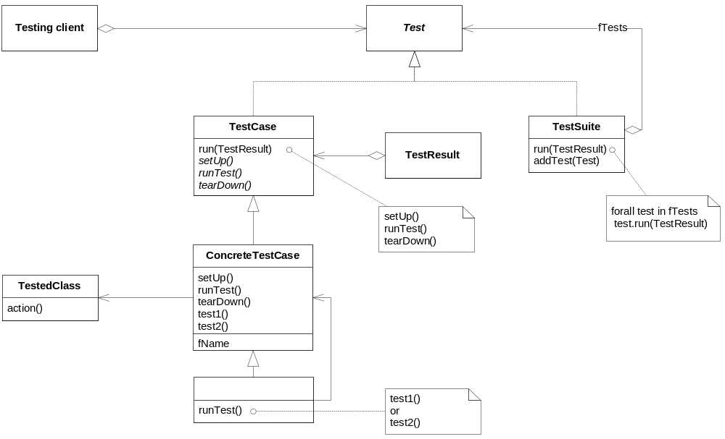
JUnit framework

Slide 30
Example: Counter class
For the sake of example, we will create and test a trivial “counter” class
  The constructor will create a counter and set it to zero
  The increment method will add one to the counter and return the new value
  The decrement method will subtract one from the counter and return the new value

Slide 31
Example: Counter class
We write the test methods before we write the code
  This has the advantages described earlier
  Depending on the JUnit tool we use, we may have to create the class first, and we may have to populate it with stubs (methods with empty bodies)
Don’t be alarmed if, in this simple example, the JUnit tests are more code than the class itself

Slide 32
JUnit tests for Counter
public class CounterTest extends junit.framework.TestCase {
Counter counter1;
public CounterTest() { } // default ctor
protected void setUp() {
// creates a (simple) test fixture
counter1 = new Counter();
}
protected void tearDown() { }
// no resources to release

Slide 33
JUnit tests for Counter…
public void testIncrement() {
assertTrue(counter1.increment()== 1);
assertTrue(counter1.increment()== 2);
}
public void testDecrement() {
assertTrue(counter1.decrement()==-1);
}
} // End from last slide

Slide 34
The Counter class itself
public class Counter {
int count = 0;
public int increment() {
return ++count;
}
public int decrement() {
return --count;
}
public int getCount() {
return count;
} }

Slide 35
Why JUnit
Allow you to write code faster while increasing quality
Elegantly simple
Check their own results and provide immediate feedback
Tests is inexpensive
Increase the stability of software
Developer tests
Written in Java
Free
Gives proper uniderstanding of unit testing

Slide 36
Problems with unit testing
JUnit is designed to call methods and compare the results they return against expected results
  This ignores:
    Programs that do work in response to GUI commands
    Methods that are used primary to produce output

Slide 37
Problems with unit testing…
Heavy use of JUnit encourages a “functional” style, where most methods are called to compute a value, rather than to have side effects
  This can actually be a good thing
  Methods that just return results, without side effects (such as printing), are simpler, more general, and easier to reuse

Slide 38
Summary: elements of JUnit
assert*()
  Comparison functions
TestCase
  Class containing a set of tests
  One per each class in production code
  Many tests for each method of a class in production code
TestSuite
  Class containing a sequence of TestCase

Slide 39
Eclipse JUnit plug-in
Notes:
Esercizi
Programmazione ad Oggetti
Marco Torchiano

Slide 40
Junit in Eclipse - Setup
In Eclipse
open project’s property window
java build path
libraries
Add external jar
  add org.junit

Slide 41
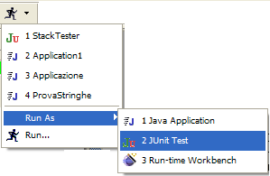
Junit in Eclipse - Run as JUnit Test
Run
Run As..
Junit Test

Slide 42
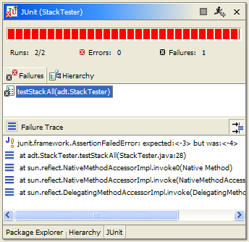

Red / Green Bar
expected <-3> but was <-4>

Slide 43
Unit Testing New Code
Unit testing can support several general strategies for validating the behavior of your software. When developing new code, write tests that:
Specify the intended outcome of code yet to be written; then write code until the tests pass. This is the ideal test-first strategy advocated by agile development principles.
Specify the correct operation for bug reports; then modify the code until these bug-fix tests pass.

Slide 44
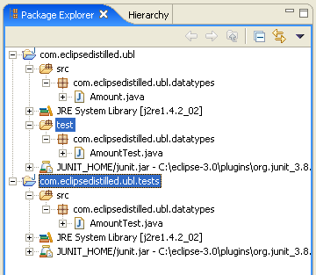
Organizing Unit Tests in Eclipse
Second source folder
  Do not put JUnit tests in the same source folder as your project code
  A second source folder allows clear separation
Separate Project
  Preferred configuration
  No unit test libraries are added to your primary project classpath
Add junit.jar to the project classpath

Slide 45
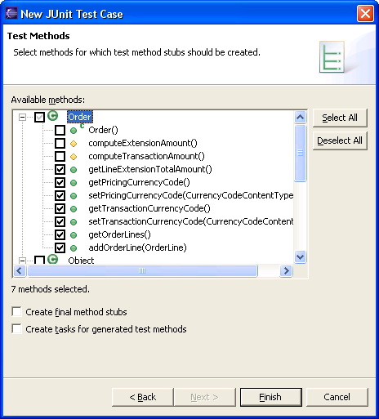
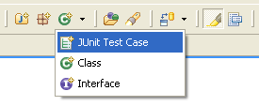
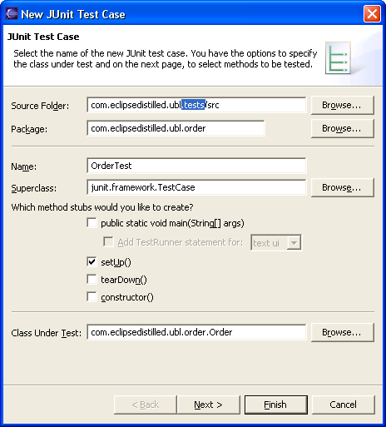
JUnit Test Case Wizard

Slide 46
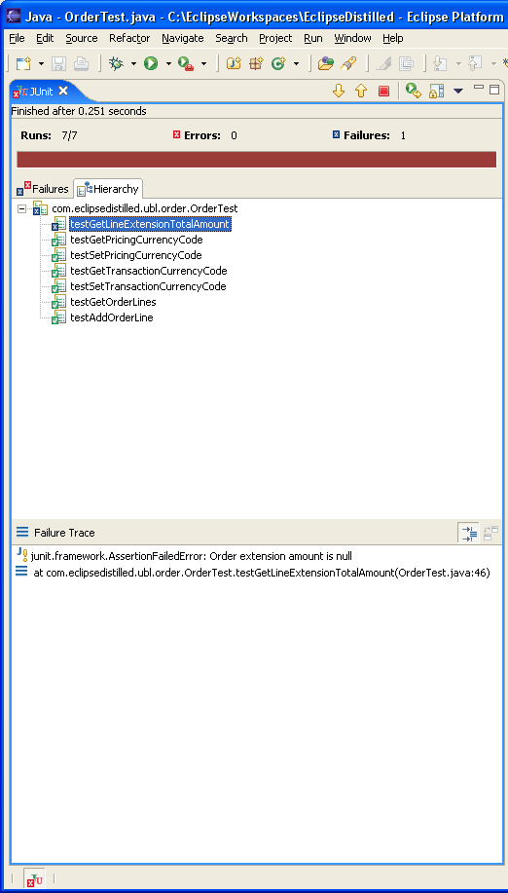
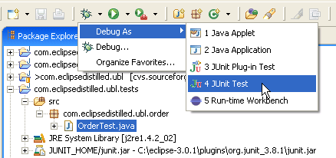
Running JUnit in Eclipse
Configure JUnit View as a Fast View
Test results summary on status bar icon
Double click error trace to go to test/app source
Failure: JUnit assertion or fail was invoked
Error: Unexpected error, e.g. NullPointerException

Slide 47
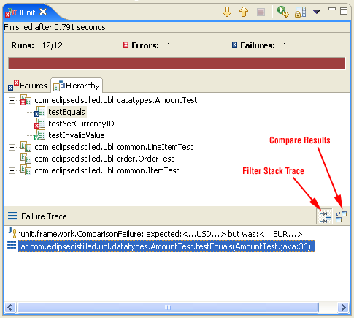
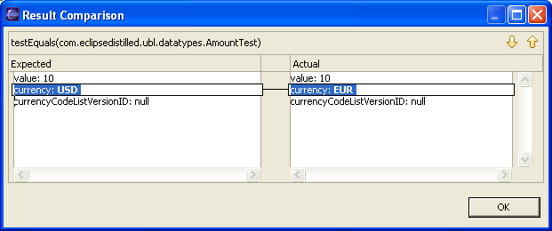
Additional Controls in JUnit View
Filter Stack Trace
  remove stack trace entries related to JUnit infrastructure
  filter is configurable in preferences
  Java > JUnit
Compare Results
  available when assertEquals() is used to compare two string value

Slide 48

…use JUnit
Keep the bar green to keep the code clean…

Slide 49
License (1)
THE WORK (AS DEFINED BELOW) IS PROVIDED UNDER THE TERMS OF THIS CREATIVE COMMONS PUBLIC LICENSE ("CCPL" OR "LICENSE"). THE WORK IS PROTECTED BY COPYRIGHT AND/OR OTHER APPLICABLE LAW. ANY USE OF THE WORK OTHER THAN AS AUTHORIZED UNDER THIS LICENSE OR COPYRIGHT LAW IS PROHIBITED.
BY EXERCISING ANY RIGHTS TO THE WORK PROVIDED HERE, YOU ACCEPT AND AGREE TO BE BOUND BY THE TERMS OF THIS LICENSE. THE LICENSOR GRANTS YOU THE RIGHTS CONTAINED HERE IN CONSIDERATION OF YOUR ACCEPTANCE OF SUCH TERMS AND CONDITIONS.
1. Definitions
  "Collective Work" means a work, such as a periodical issue, anthology or encyclopedia, in which the Work in its entirety in unmodified form, along with a number of other contributions, constituting separate and independent works in themselves, are assembled into a collective whole. A work that constitutes a Collective Work will not be considered a Derivative Work (as defined below) for the purposes of this License.
  "Derivative Work" means a work based upon the Work or upon the Work and other pre-existing works, such as a translation, musical arrangement, dramatization, fictionalization, motion picture version, sound recording, art reproduction, abridgment, condensation, or any other form in which the Work may be recast, transformed, or adapted, except that a work that constitutes a Collective Work will not be considered a Derivative Work for the purpose of this License. For the avoidance of doubt, where the Work is a musical composition or sound recording, the synchronization of the Work in timed-relation with a moving image ("synching") will be considered a Derivative Work for the purpose of this License.
  "Licensor" means the individual or entity that offers the Work under the terms of this License.
  "Original Author" means the individual or entity who created the Work.
  "Work" means the copyrightable work of authorship offered under the terms of this License.
  "You" means an individual or entity exercising rights under this License who has not previously violated the terms of this License with respect to the Work, or who has received express permission from the Licensor to exercise rights under this License despite a previous violation.
2. Fair Use Rights. Nothing in this license is intended to reduce, limit, or restrict any rights arising from fair use, first sale or other limitations on the exclusive rights of the copyright owner under copyright law or other applicable laws.
3. License Grant. Subject to the terms and conditions of this License, Licensor hereby grants You a worldwide, royalty-free, non-exclusive, perpetual (for the duration of the applicable copyright) license to exercise the rights in the Work as stated below:
  to reproduce the Work, to incorporate the Work into one or more Collective Works, and to reproduce the Work as incorporated in the Collective Works;
  to distribute copies or phonorecords of, display publicly, perform publicly, and perform publicly by means of a digital audio transmission the Work including as incorporated in Collective Works;
The above rights may be exercised in all media and formats whether now known or hereafter devised. The above rights include the right to make such modifications as are technically necessary to exercise the rights in other media and formats, but otherwise you have no rights to make Derivative Works. All rights not expressly granted by Licensor are hereby reserved, including but not limited to the rights set forth in Sections 4(d) and 4(e).

Slide 50
License (2)
4. Restrictions.The license granted in Section 3 above is expressly made subject to and limited by the following restrictions:
  You may distribute, publicly display, publicly perform, or publicly digitally perform the Work only under the terms of this License, and You must include a copy of, or the Uniform Resource Identifier for, this License with every copy or phonorecord of the Work You distribute, publicly display, publicly perform, or publicly digitally perform. You may not offer or impose any terms on the Work that alter or restrict the terms of this License or the recipients' exercise of the rights granted hereunder. You may not sublicense the Work. You must keep intact all notices that refer to this License and to the disclaimer of warranties. You may not distribute, publicly display, publicly perform, or publicly digitally perform the Work with any technological measures that control access or use of the Work in a manner inconsistent with the terms of this License Agreement. The above applies to the Work as incorporated in a Collective Work, but this does not require the Collective Work apart from the Work itself to be made subject to the terms of this License. If You create a Collective Work, upon notice from any Licensor You must, to the extent practicable, remove from the Collective Work any credit as required by clause 4(c), as requested.
  You may not exercise any of the rights granted to You in Section 3 above in any manner that is primarily intended for or directed toward commercial advantage or private monetary compensation. The exchange of the Work for other copyrighted works by means of digital file-sharing or otherwise shall not be considered to be intended for or directed toward commercial advantage or private monetary compensation, provided there is no payment of any monetary compensation in connection with the exchange of copyrighted works.
  If you distribute, publicly display, publicly perform, or publicly digitally perform the Work, You must keep intact all copyright notices for the Work and provide, reasonable to the medium or means You are utilizing: (i) the name of the Original Author (or pseudonym, if applicable) if supplied, and/or (ii) if the Original Author and/or Licensor designate another party or parties (e.g. a sponsor institute, publishing entity, journal) for attribution in Licensor's copyright notice, terms of service or by other reasonable means, the name of such party or parties; the title of the Work if supplied; and to the extent reasonably practicable, the Uniform Resource Identifier, if any, that Licensor specifies to be associated with the Work, unless such URI does not refer to the copyright notice or licensing information for the Work. Such credit may be implemented in any reasonable manner; provided, however, that in the case of a Collective Work, at a minimum such credit will appear where any other comparable authorship credit appears and in a manner at least as prominent as such other comparable authorship credit.
  For the avoidance of doubt, where the Work is a musical composition:
    Performance Royalties Under Blanket Licenses. Licensor reserves the exclusive right to collect, whether individually or via a performance rights society (e.g. ASCAP, BMI, SESAC), royalties for the public performance or public digital performance (e.g. webcast) of the Work if that performance is primarily intended for or directed toward commercial advantage or private monetary compensation.
    Mechanical Rights and Statutory Royalties. Licensor reserves the exclusive right to collect, whether individually or via a music rights agency or designated agent (e.g. Harry Fox Agency), royalties for any phonorecord You create from the Work ("cover version") and distribute, subject to the compulsory license created by 17 USC Section 115 of the US Copyright Act (or the equivalent in other jurisdictions), if Your distribution of such cover version is primarily intended for or directed toward commercial advantage or private monetary compensation.
  Webcasting Rights and Statutory Royalties. For the avoidance of doubt, where the Work is a sound recording, Licensor reserves the exclusive right to collect, whether individually or via a performance-rights society (e.g. SoundExchange), royalties for the public digital performance (e.g. webcast) of the Work, subject to the compulsory license created by 17 USC Section 114 of the US Copyright Act (or the equivalent in other jurisdictions), if Your public digital performance is primarily intended for or directed toward commercial advantage or private monetary compensation.

Slide 51
License (3)
5. Representations, Warranties and Disclaimer
UNLESS OTHERWISE MUTUALLY AGREED BY THE PARTIES IN WRITING, LICENSOR OFFERS THE WORK AS-IS AND MAKES NO REPRESENTATIONS OR WARRANTIES OF ANY KIND CONCERNING THE WORK, EXPRESS, IMPLIED, STATUTORY OR OTHERWISE, INCLUDING, WITHOUT LIMITATION, WARRANTIES OF TITLE, MERCHANTIBILITY, FITNESS FOR A PARTICULAR PURPOSE, NONINFRINGEMENT, OR THE ABSENCE OF LATENT OR OTHER DEFECTS, ACCURACY, OR THE PRESENCE OF ABSENCE OF ERRORS, WHETHER OR NOT DISCOVERABLE. SOME JURISDICTIONS DO NOT ALLOW THE EXCLUSION OF IMPLIED WARRANTIES, SO SUCH EXCLUSION MAY NOT APPLY TO YOU.
6. Limitation on Liability. EXCEPT TO THE EXTENT REQUIRED BY APPLICABLE LAW, IN NO EVENT WILL LICENSOR BE LIABLE TO YOU ON ANY LEGAL THEORY FOR ANY SPECIAL, INCIDENTAL, CONSEQUENTIAL, PUNITIVE OR EXEMPLARY DAMAGES ARISING OUT OF THIS LICENSE OR THE USE OF THE WORK, EVEN IF LICENSOR HAS BEEN ADVISED OF THE POSSIBILITY OF SUCH DAMAGES.
7. Termination
  This License and the rights granted hereunder will terminate automatically upon any breach by You of the terms of this License. Individuals or entities who have received Collective Works from You under this License, however, will not have their licenses terminated provided such individuals or entities remain in full compliance with those licenses. Sections 1, 2, 5, 6, 7, and 8 will survive any termination of this License.
  Subject to the above terms and conditions, the license granted here is perpetual (for the duration of the applicable copyright in the Work). Notwithstanding the above, Licensor reserves the right to release the Work under different license terms or to stop distributing the Work at any time; provided, however that any such election will not serve to withdraw this License (or any other license that has been, or is required to be, granted under the terms of this License), and this License will continue in full force and effect unless terminated as stated above.
8. Miscellaneous
  Each time You distribute or publicly digitally perform the Work or a Collective Work, the Licensor offers to the recipient a license to the Work on the same terms and conditions as the license granted to You under this License.
  If any provision of this License is invalid or unenforceable under applicable law, it shall not affect the validity or enforceability of the remainder of the terms of this License, and without further action by the parties to this agreement, such provision shall be reformed to the minimum extent necessary to make such provision valid and enforceable.
  No term or provision of this License shall be deemed waived and no breach consented to unless such waiver or consent shall be in writing and signed by the party to be charged with such waiver or consent.
  This License constitutes the entire agreement between the parties with respect to the Work licensed here. There are no understandings, agreements or representations with respect to the Work not specified here. Licensor shall not be bound by any additional provisions that may appear in any communication from You. This License may not be modified without the mutual written agreement of the Licensor and You.

